Slide 1
Anel DWDM Padtec DQX- MCE – CBS
Situação até 16072021
DW05CBS
SLOT 04 – PORTAS 03 (COM XFP) e 04 (COM XFP) – MCE/CH48 e DQX/CH21
SLOT 20 – PORTAS 03 (COM XFP) e 04 (SEM XFP) – MCE/CH51 e DQX/CH24
SLOT 19 – PORTAS 03 (SEM XFP) e 04 (SEM XFP) – MCE/CH54 e DQX/CH27
CH27(SL17/P1)
CH27(SL19/P1)
DW04DQX
GASDUC III
RT100DQX
SL17/P2
RT120CBS
SL4/P2
ge-2/0/0
Xe0/1/0
SL1/P2
CH54(SL19/P2)
ge-2/1/0
Xe0/1/1
10G
Xe1/1/1
CH21(SL1/P1)
OSDUC I
CH21(SL4/P1)
DW05CBS
Central Telefônica
RT101DQX
RT110CBS
SL18/P4
ETEL
Prédio 700
Clique para adicionar texto
Clique para adicionar texto
CH24(SL18/P3)
Clique para adicionar texto
ETEL
DQX
MACAÉ -> CITY GATE
CBS
RT101DQX -> RT121MCE (10G)
CH24(SL1/P1)
DQX
MCE
SL1/P2
RT101DQX
DW04DQX
DW03MCE
RT121MCE
ge-4/0/0
10G
DW03MCE
Xe 1/1/1
porta 2 - slot 17
porta 4 - slot 17
Ge 5/0/0
ge-5/0/0
Ge4/1/0
(DWDM ALU_NOKIA)
RT122MCE
CH54(SL17/P3)
RT101DQX -> RT120CBS (10G)
RT122MCE
SUBMARINO + AQUEDUTO BARRA DO FURADO
DQX
CBS
SL17/P4
RT101DQX
DW04DQX
DW04CBS
RT120CBS
Prédio 210
Prédio 111
Xe 0/1/1
porta 2 - slot 1
porta 2 - slot 4
Ge 2/0/0
DW03MCE
SLOT 18 – PORTAS 03 (COM XFP) e 04 (SEM XFP) – MCE – CH48
SLOT 01 – PORTAS 03 (COM XFP) e 04 (COM XFP) – MCE – CH51
SLOT 17 – PORTAS 03 (COM XFP) e 04 (COM XFP) – MCE – CH54
RT100DQX -> RT122MCE (10G)
MCE
DQX
MCE
RT100DQX
DW04DQX
DW03MCE
RT122MCE
Xe 0/1/0
porta 4 - slot 18
porta 2 - slot 1
Ge 4/1/0

Slide 2
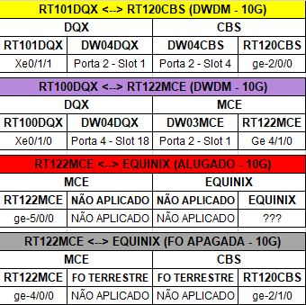
Circuitos de 10G - Anel DWDM Padtec DQX - MCE – CBS
Situação Atual (após 16072021)
RT100DQX
DW04DQX
GASDUC III (FOs 13 e 14)
DW05CBS
SL4/P2
ge-2/0/0
RT120CBS
Xe0/1/0
SL1/P2
ge-2/1/0
Xe0/1/1
10G
CH21(SL1/P1)
OSDUC I (FOs 26 e 30)
CH21(SL4/P1)
Central Telefônica
RT101DQX
RT110CBS
SL18/P4
ETEL
Prédio 700
DQX
CH24(SL18/P3)
ETEL
MACAÉ -> CITY GATE
CBS
CH24(SL1/P1)
ge-4/0/0
SL1/P2
10G
Ge4/1/0
DW03MCE
RT122MCE
ge-5/0/0
RT122MCE
SUBMARINO + AQUEDUTO BARRA DO FURADO
Prédio 210
Prédio 111
MCE
10G ALUGADO (EQUINIX)

